Slide 1
Spot filling and gap filling of high density strip noise in satellite images
An intuitive linear and non-linear approach for the Reconstruction of the original image

Slide 2
Introduction – satellite images and the various kinds of noise
Banding
Coherent noise storm
Data loss
Detector failure
Detector ringing
Detector striping
Impulse noise
Memory effect
Scan mirror pulse

Slide 3
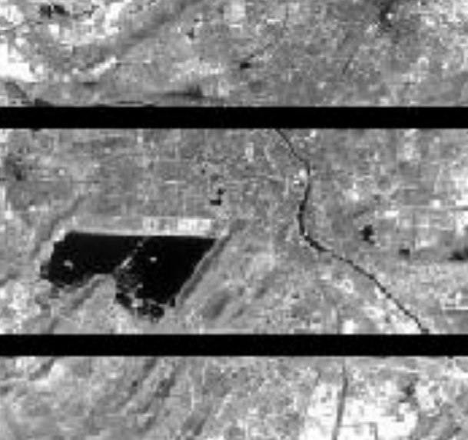
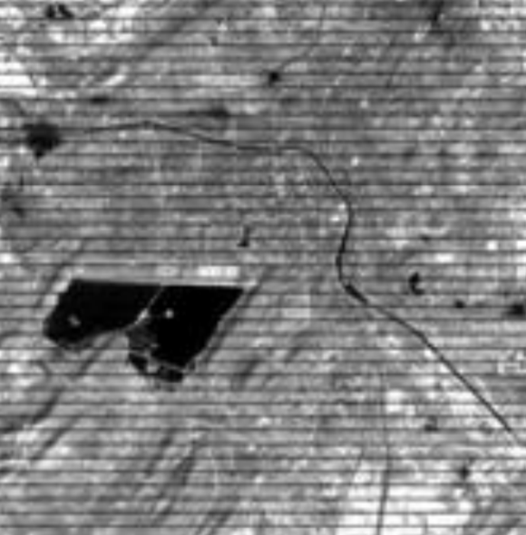
Known issues in landsat 7
Data loss
Detector Stripping

Slide 4
Why is data loss a problem?
Data loss (as a problem and not an issue) is a problem because information is fundamental for analysis and data loss is a situation where there is lack of information.
This can result in a faulty or incomplete analysis.
A faulty or incomplete analysis gives rise to a faulty prediction.

Slide 5
The Problem Statement
The gaps in satellite images can be due to many a reason. A few examples are:
instrumentation errors
gaps that may occur due to noise during transmission of data.
This loss in data has to be compensated before further analysis is performed using the images.
Problem with the Landsat7 satellite’s cognition-
The Landsat7 scan-line corrector(SLC), a mechanism designed to correct the under-sampling of the primary mirror, failed on May 31,2003. With the SLC now permanently turned off, the ETM+ is losing close to 22% of the data due to increased scan gap.
.

Slide 6
Types of solutions available for solving this issue
Multi-source methods
In Multi-Source Filling methods gap areas are filled with other image of the same scene. In Multi-Source Image gap filling gapped image can be filled with other image of same satellite. Many multi-source algorithms are proposed for reconstruction in landsat7 images. Images of Landsat7 after failure of SLC taken are known as SLC-off images which contain gapped areas.
LLHM and AWLHM being two major methods involved.
Single-source
Single source category mostly is based on within image pixel similarities/dissimilarity rules where gapped areas are constructed using non-gapped areas in the image itself.
In averaging method line drop is overcome by replacing zero value by means of all the pixels in previous and following lines. For modern detector stripping is along with column instead of row.
Hybrid
Hybrid method is combination of single source and multi-source method for filling gaps in satellite images.

Slide 7
Single Source methods
The Need for Single Source methods:
The need for single source methods arises when the scans performed by the satellite are in areas where there is a drastic geographical change compared to the latest scans and if the information from the previous scans can be resourceful in analyzing the change in geography or features of a particular landscape over a period of time.
The initial conditions of a feature or a relief in a geographical expanse can be properly estimated if the images with noise and aberrations are first reconstructed before a comparative study and analysis is performed.
This can help us provide lossless data or data with very slight deviations from originality for comparison purposes that will result in an accurate analysis and a precise forecast.

Slide 8
Techniques Proposed for reconstruction of image
Inpainting:
Inpainting is the process of filling missing data in an image in a plausible way such that it cannot be detectable. The Definition of ‘missing data’ is left to the interpretation of the user of the algorithm.
Morphological image processing:
Morphological image processing is a collection of non-linear operations related to a shape or morphology of features in an image. Morphological operations are more suitable to binary images but can also be used for greyscale images such that their light transfer functions are unknown and therefore their absolute pixel values are of no or minor interest.

Slide 9
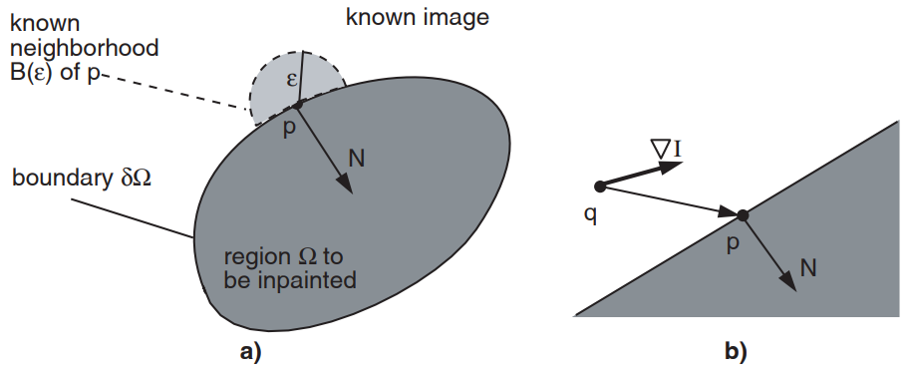
A little more on inpainting

Slide 10
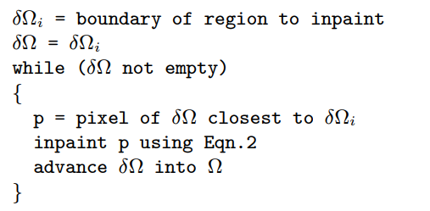

Slide 11
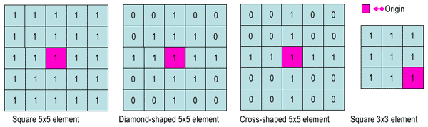
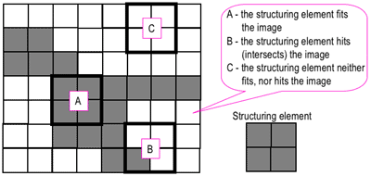
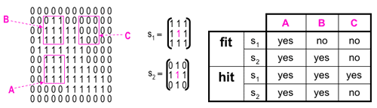
A little more on morphological image processing

Slide 12
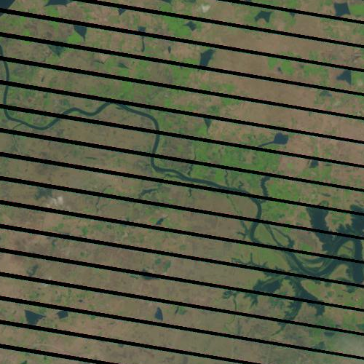
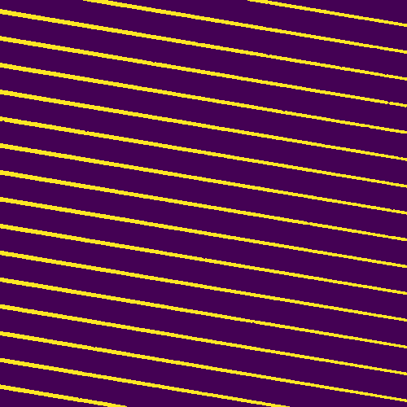
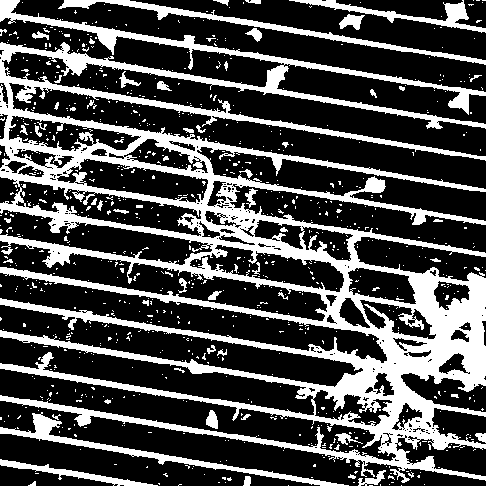
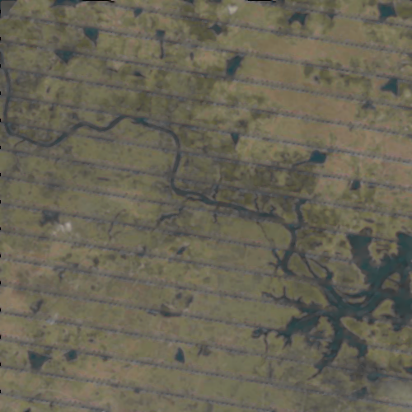
New challenges faced and Techniques developed for optimized results

Slide 13
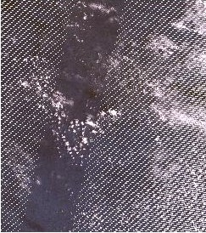
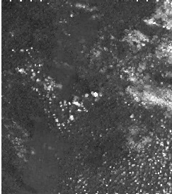
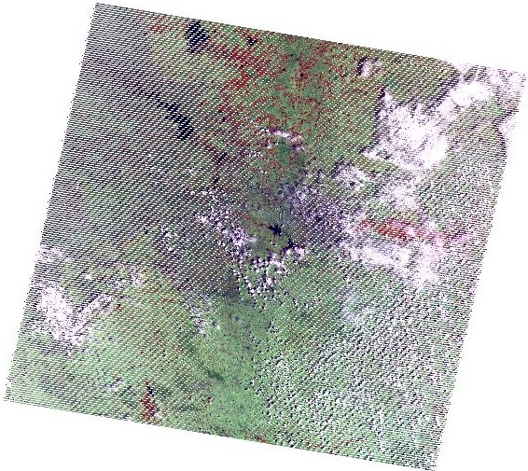
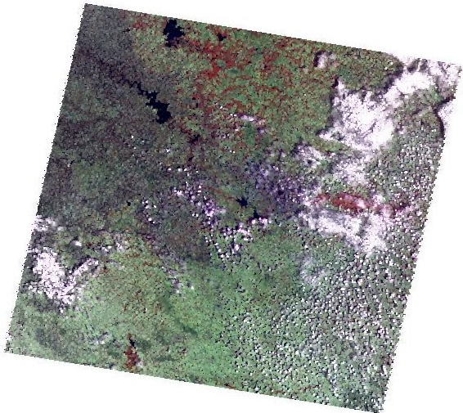
…..

Slide 14
Advantages of the methods Proposed:
The inpainting algorithm developed and used in this paper produce faster results
that is an (400 px : 300 px ) image takes less than 3 minutes to be inpainted on a system with a 500mb RAM and a 800Mhz processor. Which means this system can be realized using low cost and high power hardware.
The morphological image processing techniques proposed in this paper are adaptive and can be optimized using techniques like LBP after feature detection to give better results that can be used for sustainable analysis.
The data obtained after the reconstruction of images can be used for period analysis of landscapes and Geo Reliefs(especially considering the failure of SLC on landsat7)

Slide 15
Any Queries ?

Slide 16
Thank You all

